Slide 1
Selection of priority sectors for CBE development
Gintautas Jakštas Baku, 2018 July

Slide 2
PRESENTATION OUTLINE
Smart specialization
What is Smart specialisation?
The process: From analysis to implementation
Priorities in Lithuania
Azerbaijan strategic road map
Competency-based Education

Slide 3
Smart Specialisation

Slide 4
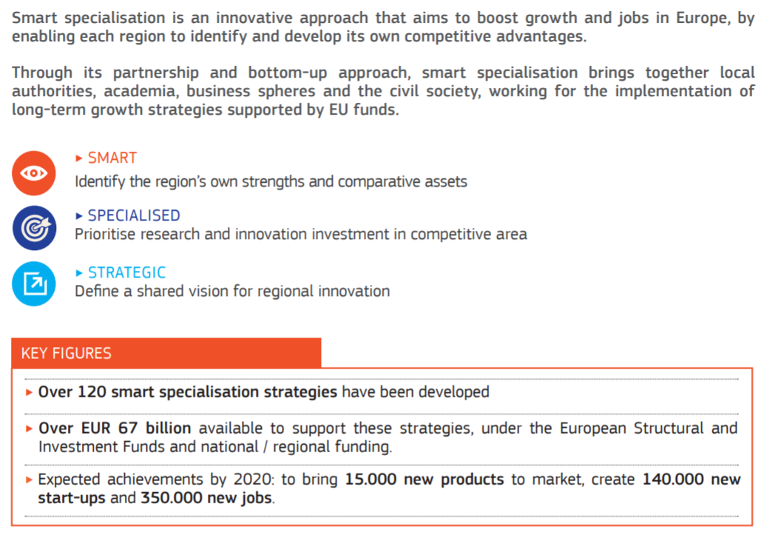
What is Smart specialization?

Slide 5
The process: From analysis to implementation
1
Priority field
6 broad Priority fields
Analysis of challenges, research potential and structure of economy
2
Priorities
20 Priorities within 6 broad Priority fields
In-depth analysis in every Priority field + expert panels
3
Roadmaps
For every Priority (total 20 roadmaps)
Expert panels + broad survey
4
Priority implementation plans
Developed according to roadmaps (total 20 plans)
Consultation with National expert institutions + implementing ministries

Slide 6
Priorities in Lithuania
Agro-innovation and food technologies
Safer food and sustainable usage of biomaterials
Functional food
Innovative development, improvement and processing of biological raw materials (biorefinery)
Energy and sustainable environment
Smart systems for energy efficiency, diagnostic, monitoring, metering and management of generators, grids and customers
Energy and fuel production using biomass/waste and waste treatment, storage and disposal
Technology for the development and use of smart low-energy buildings – digital construction
Solar energy installations and technologies for using them for the power generation , heating and cooling
Health technologies and biotechnology
Molecular technologies for medicine and biopharmaceutics
Advanced applied technologies for individual and public health
Advanced medical engineering for early diagnostics and treatment
Inclusive and creative society
Modern self-development technologies and processes promoting formation of creative and productive individuals
Technologies and processes for the development and implementation of breakthrough innovations
Novel production processes, materials and technologies
Photonic and laser technologies
Functional materials and coatings
Structural and composite materials
Flexible technological systems for product development and fabrication
Transport, logistics and information and communication technologies
Advanced electronic content, content development technologies and information interoperability
ICT infrastructure, cloud computing solutions and services
Smart transport systems and ICT
Technologies/models for the international transport corridors’ management and integration of modes of transport

Slide 7
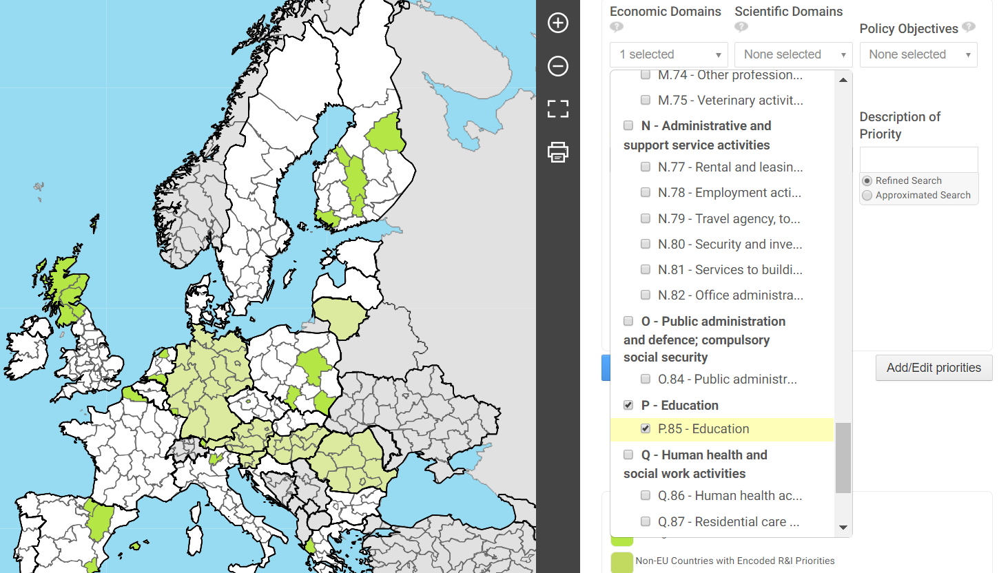
Smart specialization platform
Notes:
Platform enables public managers and stakeholders to position their territory in comparison to other territories and to find potential partners for collaboration. Inside the EU.
National Smart specialization priorities are used in research financing, selection of national projects. Based on national priorities institutional priorities are shaped.

Slide 8
Azerbaijan Strategic Road map

Slide 9
Azerbaijan strategic road map
In late 2016, the President approved a strategic roadmap for economic reforms that identified key non-energy segments of the economy for development, such as agriculture, logistics, information technology, and tourism.
12 Strategic Roadmaps Endorsed in Azerbaijan aim to define the country`s development goals and priorities and ensure their implementation
Well developed methodology:
Primary objectives
Analysis of current situation
Global trends
Potential
Primary market opportunities
SWOT analysis of sector
Strategic vision
2020
Long term vision for 2025
Target Indicators, Strategic Objectives and Targets, Financial Mechanism
Implementation, Monitoring and Evaluation

Slide 10
STRATEGIC ROAD MAP FOR DEVELOPMENT OF SECTORS IN THE REPUBLIC OF AZERBAIJAN
Tourism SWOT analysis, weaknesses:
Training of skilled workers does not meet labor market requirements both from quality and quantity perspectives;
Relatively less foreign language speakers in regions.
Agricultural products SWOT analysis weaknesses:
low fertility indices as a result of narrow dissemination of the implementation practice of advanced farming methods, great role of extensive factors in growth of production of most products.
inadequate knowledge and skills of farmers in relevant fields to carry out activities with advanced methods;
SWOT analysis of logistics and trade sector, weaknesses:
small potential for qualified personnel in logistics;
low labor productivity.

Slide 11
Competency-based Education

Slide 12
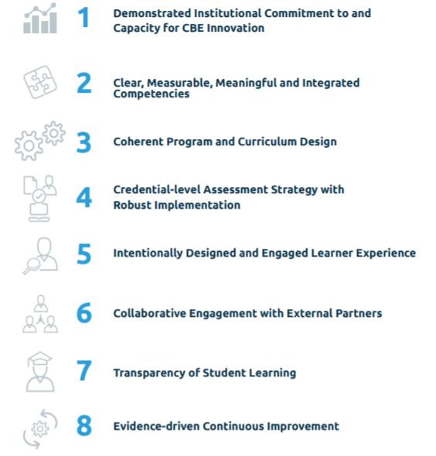
ELEMENTS OF QUALITY FOR COMPETENCY-BASED EDUCATION by Competency-based Education Network
Notes:
In order to produce a high-quality CBE program, the institution must build a foundational infrastructure in support of competency-based education. This includes the development of a CBE philosophy and commitment as it relates to the institution’s mission, the design of the program structure and the definition of appropriate supports for the program and its learners
Each competency is explicitly stated and provides unambiguous descriptions of what a learner must master to complete a program of study. Each competency includes the theory and the application of theory required for mastery at the appropriate level for the credential being earned
Competency-based education programs use an intentional and transparent approach to curricular design that provides a learner with the full range of competencies necessary to meet post-graduation demands. This academic model, which provides clear pathways to completion, builds a unified body of knowledge that leverages frameworks, disciplines, standards, national norms and workforce
Authentic assessments and their corresponding rubrics are key components of CBE, which is anchored by the belief that progress toward a credential should be determined by what learners know and are able to do. The overarching assessment strategy is comprised of assessments designed both to inform the learning journey and to validate mastery
CBE professionals (faculty and staff) comprehensively understand the strengths and needs of their target learner population, and put those needs at the core of all decisions, processes and systems. CBE programs offer proactive and personalized support for learners, from determining program fit through alumni relations. Faculty and staff are invested in and involved with understanding and improving the entire learner lifecycle by designing, guiding and supporting the learning journey, including processes that facilitate and encourage meaningful interaction with individual learners. A full array of wraparound learner services and social supports, appropriate to the learners being served, is offered by CBE professionals through a wide range of roles and responsibilities
Institutions strategically identify and secure the commitment of multiple external partners to inform and support the achievement of their CBE programs’ purpose and their institutional equity goals. External partners are meaningfully engaged in the design, delivery and evaluation of the institutions’ CBE programs. They work collaboratively to inform and validate CBE program competencies and curriculum, and to ensure the authenticity of assessments. The result is a relevant, transparent credential and authentic learning experience that is endorsed and trusted by external partners as well as learners.
One of the central differentiators of CBE programs is their transparency regarding the learning required to earn a credential. This means that the competencies and their alignment, the pathway to mastering those competencies, the assessment methodologies and the performance requirements for successful demonstration of competency are clearly articulated to learners and all other stakeholders.
An evidence-driven, continuous improvement methodology is an essential dimension of competency-based education. To ensure program effectiveness, data are collected and analyzed at regular intervals during the program and post-completion. These data are reported and used to inform learners and faculty, identify and prioritize improvements, evaluate and refine assessment strategy and implementation, monitor learner achievement across diverse groups. Where performance gaps are identified, the institution actively implements and monitors solutions.

Slide 13
Economy sectors: Employment and GDP
In Agriculture sector work 37 percent workers and generate 6 percent of GDP
In Services work 49 percent workers and generate 42 percent of GDP
In industry work only 14 percent of workers and this sector generates 52 percent of GDP
Manufacture of tobacco products 2010: 0,6% pop – 0,08% GDP, 2016: 0,3% pop – 0,14% GDP
Metallurgy industry 2010: 8,3% pop – 0,5% GDP, 2016: 3,9% pop – 1% GDP
Manufacture of food products 2010: 15,1% pop – 1,5% GDP, 2016: 18,8% pop – 4,3% GDP
Manufacture of rubber and plastics products 2010: 4% pop – 0,2% GDP, 2016: 5,5% pop – 0,6% GDP
Inner Circle - Share of economic sectors in the GDP, 2016
Outer Circe - Distribution of employment by economic sector, 2016

Slide 14
Selection of priority sectors for the development of competence-based education standards
Capacity
National priorities
CBE priorities
Notes:
My task is to suggest three priority areas for the improvement of competence-based education standards on the basis of economic and social relevance. One possbile way to do it is to analyze current situation of economic sectors and performance of graduates. However we couldn‘t find oficial data with graduates emplyment indicators on program level. Onother posible way is to adopt priority sectors from Azerbaijan strategic road map. Center for analysisof economic reforms and communication analysed sectors, identified weaknesses and development of competence based education stadards can be helpfull to overcome those challenges.
Knowing that implementing CBE model requires a huge input from universities, in order to succed it is essential to select priority programs where are the highest level of excellence both from teachers and administration in universities.
So my suggestion would be to select priority sectors based on national priorities and capacity of universities.

